Slide 1
Memory and Programmable Logic
Introduction;
Random-Access Memory; Memory Decoding;
Error Detection and Correction

Slide 2
Introduction
A memory unit is a device to which binary information is transferred for storage and from which information is retrieved when needed for processing.
Binary information received from an input device is stored in memory and information transferred to an output device is taken from memory.
A memory unit is a collection of cells capable of storing a large quantity of binary information.

Slide 3
There are two types of memories that are used in digital systems: random‐access memory (RAM) and read‐only memory (ROM).
RAM stores new information for later use.
The process of storing new information into memory is referred to as a memory write operation.
The process of transferring the stored information out of memory is referred to as a memory read operation.
RAM can perform both write and read operations.

Slide 4
ROM can perform only the read operation.
This means that suitable binary information is already stored inside memory and can be retrieved or read at any time. However, that information cannot be altered by writing.
ROM is a programmable logic device (PLD).
The binary information that is stored within such a device is specified in some fashion and then embedded within the hardware in a process is referred to as programming the device.

Slide 5
ROM is one example of a PLD. Other such units are the programmable logic array (PLA), programmable array logic (PAL), and the field‐programmable gate array (FPGA).
A PLD is an integrated circuit with internal logic gates connected through electronic paths that behave similarly to fuses.
In the original state of the device, all the fuses are intact.

Slide 6
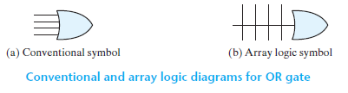
Programming the device involves blowing those fuses along the paths that must be removed in order to obtain the particular configuration of the desired logic function.

Slide 7
Random-Access Memory
A memory unit is a collection of storage cells, together with associated circuits needed to transfer information into and out of a device.
A memory unit stores binary information in groups of bits called words.
A memory word is a group of 1’s and 0’s and may represent a number, an instruction, one or more alphanumeric characters, or any other binary‐coded information.

Slide 8
A group of 8 bits is called a byte.
Most computer memories use words that are multiples of 8 bits in length.
Thus, a 16‐bit word contains two bytes, and a 32‐bit word is made up of four bytes.
The capacity of a memory unit is usually stated as the total number of bytes that the unit can store.

Slide 9
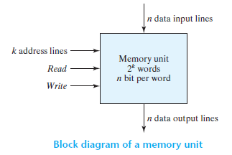
Communication between memory and its environment is achieved through data input and output lines, address selection lines, and control lines that specify the direction of transfer.
A block diagram of a memory unit is shown in Figure.

Slide 10
The n data input lines provide the information to be stored in memory, and the n data output lines supply the information coming out of memory.
The k address lines specify the particular word chosen among the many available.
The two control inputs specify the direction of transfer desired: the Write input causes binary data to be transferred into the memory, and the Read input causes binary data to be transferred out of memory.

Slide 11
The memory unit is specified by the number of words it contains and the number of bits in each word.
It is customary to refer to the number of words (or bytes) in memory with one of the letters K (kilo), M (mega), and G (giga).
K is equal to 2¹⁰, M is equal to 2²⁰, and G is equal to 2³⁰.
Thus, 64K = 2⁶ × 2¹⁰ = 2¹⁶, 2M = 2¹ × 2²⁰ = 2²¹, and 4G = 2² × 2³⁰ = 2³².

Slide 12
Consider, for example, a memory unit with a capacity of 1K words of 16 bits each.
Since 1K = 1,024 = 2¹⁰ and 16 bits constitute two bytes, we can say that the memory can accommodate 2,048 = 2K bytes.
The 1K × 16 memory has 10 bits in the address and 16 bits in each word.
As another example, a 64K × 10 memory will have 16 bits in the address (since 64K = 2¹⁶) and each word will consist of 10 bits.

Slide 13
The number of address bits needed in a memory is dependent on the total number of words that can be stored in the memory and is independent of the number of bits in each word.
The number of bits in the address is determined from the relationship 2^{k} ≥ m, where m is the total number of words and k is the number of address bits needed to satisfy the relationship.

Slide 14
Problem
The memory units that follow are specified by the number of words times the number of bits per word. How many address lines and input-output data lines are needed in each case?
(a) 8K × 16 (b) 2G × 8
(c) 16M × 32 (d) 256K × 64

Slide 15
Solution:
(a) 8K × 16 = 2³ × 2¹⁰ × 16 = 2¹³ × 16
Address lines = 13 and
Input-output data lines = 16
(b) 2G × 8 = 2¹ × 2³⁰ × 8 = 2³¹ × 8
Address lines = 31 and
Input-output data lines = 8
(c) 16M × 32 = 2⁴ × 2²⁰ × 32 = 2²⁴ × 32
Address lines = 24 and
Input-output data lines = 32
(d) 256K × 64 = 2⁸ × 2¹⁰ × 64 = 2¹⁸ × 64
Address lines = 18 and
Input-output data lines = 64

Slide 16
Write and Read Operations
The steps that must be taken for the purpose of transferring a new word to be stored into memory are as follows:
  1. Apply the binary address of the desired word to the address lines.
  2. Apply the data bits that must be stored in memory to the data input lines.
  3. Activate the write input.
The memory unit will then take the bits from the input data lines and store them in the word specified by the address lines.

Slide 17
The steps that must be taken for the purpose of transferring a stored word out of memory are as follows:
  1. Apply the binary address of the desired word to the address lines.
  2. Activate the read input.
The memory unit will then take the bits from the word that has been selected by the address and apply them to the output data lines.

Slide 18
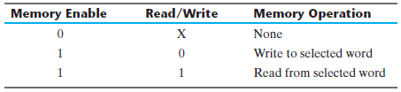
Instead of having separate read and write inputs to control the two operations, most integrated circuits provide two other control inputs: one input selects the unit and the other determines the operation.
The memory enable (sometimes called the chip select) is used to enable the particular memory chip in a multichip implementation of a large memory.

Slide 19
Types of Memories
Integrated circuit RAM units are available in two operating modes: static and dynamic.
Static RAM (SRAM) consists essentially of internal latches that store the binary information. The stored information remains valid as long as power is applied to the unit.
Dynamic RAM (DRAM) stores the binary information in the form of electric charges on capacitors provided inside the chip by MOS transistors.

Slide 20
The stored charge on the capacitors tends to discharge with time, and the capacitors must be periodically recharged by refreshing the dynamic memory.
DRAM offers reduced power consumption and larger storage capacity in a single memory chip.
SRAM is easier to use and has shorter read and write cycles.

Slide 21
Memory units that lose stored information when power is turned off are said to be volatile.
CMOS integrated circuit RAMs, both static and dynamic, are volatile memory, since the binary cells need external power to maintain the stored information.
In contrast, a nonvolatile memory, such as magnetic disk, retains its stored information after the removal of power.

Slide 22
Memory Decoding
In addition to requiring storage components in a memory unit, there is a need for decoding circuits to select the memory word specified by the input address.

Slide 23
Internal Construction
The internal construction of a RAM of m words and n bits per word consists of m × n binary storage cells and associated decoding circuits for selecting individual words.
The binary storage cell is the basic building block of a memory unit.
The equivalent logic of a binary cell that stores one bit of information is shown in Figure.

Slide 24
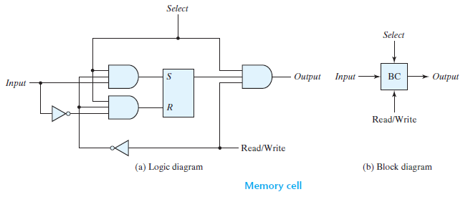
The storage part of the cell is modeled by an SR latch with associated gates to form a D latch.

Slide 25
The binary cell stores one bit in its internal latch.
The select input enables the cell for reading or writing, and the read/write input determines the operation of the cell when it is selected.
A 1 in the read/write input provides the read operation by forming a path from the latch to the output terminal.
A 0 in the read/write input provides the write operation by forming a path from the input terminal to the latch.

Slide 26
The logical construction of a 4 × 4 RAM is shown in Figure.
The RAM consists of four words of four bits each and has a total of 16 binary cells.
The small blocks labeled BC represent the binary cell with its three inputs and one output.
A memory with four words needs two address lines. The two address inputs go through a 2 × 4 decoder to select one of the four words.
The decoder is enabled with the memory‐enable input.

Slide 27
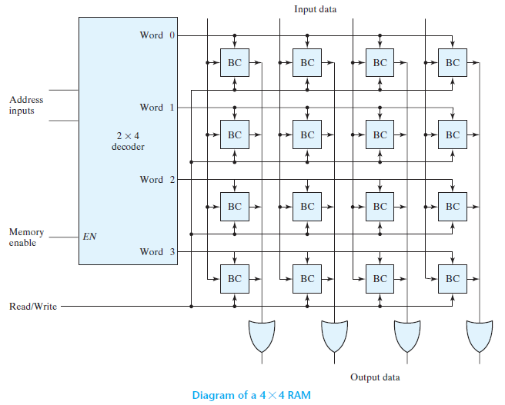

Slide 28
When the memory enable is 0, all outputs of the decoder are 0 and none of the memory words are selected.
With the memory select at 1, one of the four words is selected, dictated by the value in the two address lines.
Once a word has been selected, the read/write input determines the operation.
During the read operation, the four bits of the selected word go through OR gates to the output terminals.

Slide 29
During the write operation, the data available in the input lines are transferred into the four binary cells of the selected word.
The binary cells that are not selected are disabled, and their previous binary values remain unchanged.
When the memory select input that goes into the decoder is equal to 0, none of the words are selected and the contents of all cells remain unchanged regardless of the value of the read/write input.

Slide 30
A memory with 2^{k} words of n bits per word requires k address lines that go into a k × 2^{k} decoder.
Each one of the decoder outputs selects one word of n bits for reading or writing.

Slide 31
Coincident Decoding
A decoder with k inputs and 2^{k} outputs requires 2^{k} AND gates with k inputs per gate.
The total number of gates and the number of inputs per gate can be reduced by employing two decoders in a two‐dimensional selection scheme.
The basic idea in two‐dimensional decoding is to arrange the memory cells in an array that is close as possible to square.
In this configuration, two k/2‐input decoders are used instead of one k ‐input decoder.

Slide 32
One decoder performs the row selection and the other the column selection in a two‐dimensional matrix configuration.
The two‐dimensional selection pattern is demonstrated in Figure for a 1K‐word memory. Instead of using a single 10 × 1,024 decoder, we use two 5 × 32 decoders.
With the single decoder, we would need 1,024 AND gates with 10 inputs in each. In the two‐decoder case, we need 64 AND gates with 5 inputs in each.

Slide 33
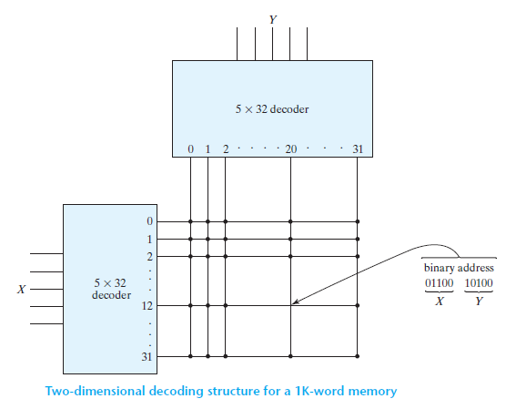

Slide 34
The five most significant bits of the address go to input X and the five least significant bits go to input Y.
Each word within the memory array is selected by the coincidence of one X line and one Y line.
Thus, each word in memory is selected by the coincidence between 1 of 32 rows and 1 of 32 columns, for a total of 1,024 words.
Note that each intersection represents a word that may have any number of bits.

Slide 35
As an example, consider the word whose address is 404.
The 10‐bit binary equivalent of 404 is 01100 10100.
This makes X = 01100 (binary 12) and Y = 10100 (binary 20).
The n ‐bit word that is selected lies in the X decoder output number 12 and the Y decoder output number 20.
All the bits of the word are selected for reading or writing.

Slide 36
Problem
(a) How many 32K × 8 RAM chips are needed to provide a memory capacity of 256K bytes?
(b) How many lines of the address must be used to access 256K bytes? How many of these lines are connected to the address inputs of all chips?
(c) How many lines must be decoded for the chip select inputs? Specify the size of the decoder.

Slide 37
Solution:
32K × 8 = 2⁵ × 2¹⁰ × 8 = 2¹⁵ × 8
256K bytes = 256K × 8 = 2⁸ × 2¹⁰ × 8 = 2¹⁸ × 8
2¹⁸ × 8 / 2¹⁵ × 8 = 2¹⁸⁻¹⁵ = 2³ = 8
Eight 32K × 8 RAM chips are needed to provide a memory capacity of 256K bytes.
(b) 18 lines of the address must be used to access 256K bytes. 15 of these lines are connected to the address inputs of all chips.
(c) 18 - 15 = 3 lines must be decoded for the chip select inputs. The size of the decoder is 3 × 2³ = 3 × 8.

Slide 38
Error Detection and Correction
The dynamic physical interaction of the electrical signals affecting the data path of a memory unit may cause occasional errors in storing and retrieving the binary information.
The reliability of a memory unit may be improved by employing error‐detecting and error‐correcting codes.

Slide 39
The most common error detection scheme is the parity bit. A parity bit is generated and stored along with the data word in memory. The parity of the word is checked after reading it from memory.
An error‐correcting code generates multiple parity check bits that are stored with the data word in memory. Each check bit is a parity over a group of bits in the data word.

Slide 40
Hamming Code
One of the most common error‐correcting codes used in RAMs was devised by R. W. Hamming.
In the Hamming code, k parity bits are added to an n‐bit data word, forming a new word of n + k bits.
The bit positions are numbered in sequence from 1 to n + k.
Those positions numbered as a power of 2 are reserved for the parity bits. The remaining bits are the data bits.
The code can be used with words of any length.

Slide 41

Consider, for example, the 8‐bit data word 11000100.
We include 4 parity bits with the 8‐bit word and arrange the 12 bits as follows:
The 4 parity bits, P₁, P₂, P₄, and P₈, are in positions 1, 2, 4, and 8, respectively.
The 8 bits of the data word are in the remaining positions.

Slide 42
Each parity bit is calculated as follows:
P₁ = XOR of bits (3, 5, 7, 9, 11)
= 1 Ꚛ 1 Ꚛ 0 Ꚛ 0 Ꚛ 0 = 0
P₂ = XOR of bits (3, 5, 7, 10, 11)
= 1 Ꚛ 0 Ꚛ 0 Ꚛ 1 Ꚛ 0 = 0
P₄ = XOR of bits (5, 6, 7, 12)
= 1 Ꚛ 0 Ꚛ 0 Ꚛ 0 = 1
P₈ = XOR of bits (9, 10, 11, 12)
= 0 Ꚛ 1 Ꚛ 0 Ꚛ 0 = 1

Slide 43

The 8‐bit data word is stored in memory together with the 4 parity bits as a 12‐bit composite word.
Substituting the 4 P bits in their proper positions, we obtain the 12‐bit composite word stored in memory:

Slide 44
When the 12 bits are read from memory, they are checked again for errors.
The parity is checked over the same combination of bits, including the parity bit.
The 4 check bits are evaluated as follows:
C₁ = XOR of bits (1, 3, 5, 7, 9, 11)
C₂ = XOR of bits (2, 3, 5, 7, 10, 11)
C₄ = XOR of bits (4, 5, 6, 7, 12)
C₈ = XOR of bits (8, 9, 10, 11, 12)

Slide 45
A 0 check bit designates even parity over the checked bits and a 1 designates odd parity.
Since the bits were stored with even parity, the result, C = C₈C₄C₂C₁ = 0000, indicates that no error has occurred.
However, if C ≠ 0, then the 4‐bit binary number formed by the check bits gives the position of the erroneous bit.

Slide 46
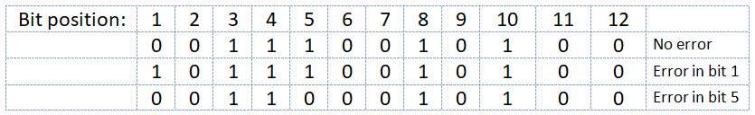
For example, consider the following three cases:
In the first case, there is no error in the 12‐bit word.
In the second case, there is an error in bit position number 1 because it changed from 0 to 1.
The third case shows an error in bit position 5, with a change from 1 to 0.

Slide 47
Evaluating the XOR of the corresponding bits, we determine the 4 check bits to be as follows:
C₈ C₄ C₂ C₁
For no error: 0 0 0 0
With error in bit 1: 0 0 0 1
With error in bit 5: 0 1 0 1
Thus, for no error, we have C = 0000; with an error in bit 1, we obtain C = 0001; and with an error in bit 5, we get C = 0101.

Slide 48
When the binary number C is not equal to 0000, it gives the position of the bit in error. The error can be corrected by complementing the corresponding bit.
Note that an error can occur in the data word or in one of the parity bits.

Slide 49
The Hamming code can be used for data words of any length.
In general, the Hamming code consists of k check bits and n data bits, for a total of n + k bits.
The range of k must be equal to or greater than n + k, giving the relationship 2^{k} - 1 ≥ n + k
Solving for n in terms of k, we obtain 2^{k} - 1 - k ≥ n
This relationship gives a formula for establishing the number of data bits that can be used in conjunction with k check bits.

Slide 50
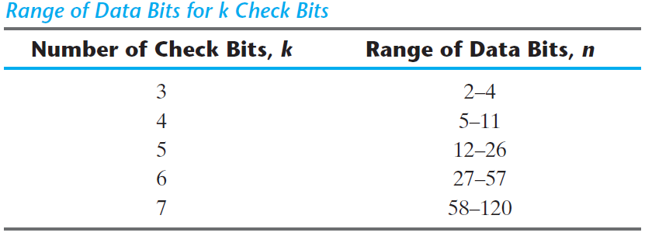

Slide 51
The grouping of bits for parity generation and checking can be determined from a list of the binary numbers from 0 through 2^{k} - 1.
The least significant bit is a 1 in the binary numbers 1, 3, 5, 7, and so on. The second significant bit is a 1 in the binary numbers 2, 3, 6, 7, and so on.
Note that each group of bits starts with a number that is a power of 2: 1, 2, 4, 8, 16, etc. These numbers are also the position numbers for the parity bits.

Slide 52
Single‐Error Correction, Double‐Error Detection
The Hamming code can detect and correct only a single error.
By adding another parity bit to the coded word, the Hamming code can be used to correct a single error and detect double errors.
If we include this additional parity bit, then the previous 12‐bit coded word becomes 001110010100P₁₃, where P₁₃ is evaluated from the exclusive‐OR of the other 12 bits.

Slide 53
This produces the 13‐bit word 0011100101001 (even parity).
When the 13‐bit word is read from memory, the check bits are evaluated, as is the parity P over the entire 13 bits.
If P = 0, the parity is correct (even parity), but if P = 1, then the parity over the 13 bits is incorrect (odd parity).

Slide 54
The following four cases can arise:
If C = 0 and P = 0, no error occurred.
If C ≠ 0 and P = 1, a single error occurred that can be corrected.
If C ≠ 0 and P = 0, a double error occurred that is detected, but that cannot be corrected.
If C = 0 and P = 1, an error occurred in the P₁₃ bit.
This scheme may detect more than two errors, but is not guaranteed to detect all such errors.
Integrated circuits use a modified Hamming code to generate and check parity bits for single‐error correction and double‐error detection.

